Slide 1
Anthropac

Slide 2
Outline
Anthropac runs in a DOS window.
To install Anthropac (Windows 7 or higher), see video by Rosalyn Negrón.
This intro will explain why we use a Anthropac (AP).
And we will explore AP’s features
Here is the opening screen:

Slide 3
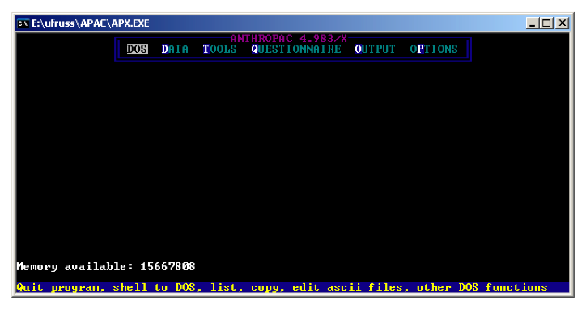

Slide 4
File formats
In the DOS menus, use the CD command to move to the folder where you have your data.
Folders and files may have up to 8 characters. Files may also have a 3-letter extension, as in dogs.txt
Anthropac imports ASCII (plain text) files. Use the Notebook application to build text files, or save as text if you build files in a word processor.

Slide 5
File formats, cont.
Anthropac uses its own data format. It creates two files: *.##H and *.##D
If you move Anthropac files from one folder to another, be sure to move both pieces of each file.

Slide 6
Output log
Every time you run an AP program, it creates an ASCII file called output.log
Change this in OPTIONS to Output.txt so you can open it automatically in Notepad
You can open and edit that file, but be sure to save it with a different name if you want to keep it.
You can append output to the output.log file, but use this function (^a) with caution.

Slide 7
Each program has an input window. This is typically black and white, as in the following:
Each line of the input window is accompanied by a yellow line below it that explains what is needed.

Slide 8
Matrices
All Anthropac data are matrices.
Some matrices are one column wide or one row deep.
The following are all examples of matrices (see p. 20 of the AP Guide)

Slide 9
AP menu
The three most important components of the main menu in AP are DATA, TOOLS, and QUESTIONNAIRE.

Slide 10
The DATA menu
The set of importing routines (for freelists, wordlists, pile sorts and triad tests) are not available in any other program.
AP has a built-in spreadsheet (for editing AP matrices) and routines for sorting and transposing matrices and for dichotomizing and recoding data.
However, all of these are easier to do in UCINET.

Slide 11
The TOOLS menu
This includes: MDS, cluster analysis, correspondence analysis, consensus analysis, QAP, PROFIT; procedures for creating similarity and dissimilarity matrices; univariate statistics.
All of these are easier to do in UCINET
The routines for testing Likert and Guttman scales and for boolean analysis of a truth table are not available elsewhere.

Slide 12
The QUESTIONNAIRE menu
This is for creating structured questionnaires, including:
triads tests
paired comparisons
ratings
rankings
The routines for paired comparisons and triad tests are not widely available in other programs

Slide 13
Importing data
Use the DL (data language) function to import ASCII data.
You can specify the column and row labels in the DL file.
See the AP manual for instructions on the use of the data language.

